Slide 1
Zoom
For Intermediate Users

Slide 2
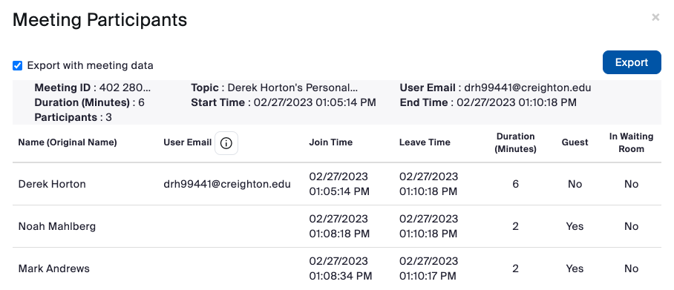
Downloading Attendance Reports
To download attendance reports, go to Creighton.zoom.us and log in.
Once logged in, on the left-hand side click where it says Reports
This will bring up a popup window. Click where it says Export with meeting data and click Export.
https://www.youtube.com/watch?v=g6RWIDaqBRM

Slide 3
Saving Gallery View(Seating Chart)
Verify the setting is turned on in your meeting settings at Creighton.zoom.us
The meeting needs to be reoccurring with the same Zoom meeting id
Once the meeting has started, you can drag and drop the attendees where you want them placed.
Click on the icon.
Click Save View Order
https://support.zoom.us/hc/en-us/articles/4413866054285

Slide 4
Spotlight Participants
If you have a particular student presenting to the class, this will allow you to make them the primary speaker.
If a group of students is presenting, you can spotlight up to 9 participants.
To Spotlight a student, click on the three-dot icon in the upper right of their image and choose Spotlight for everyone.
To spotlight another student, repeat the steps above but click Add Spotlight instead of Spotlight for everyone.

Slide 5
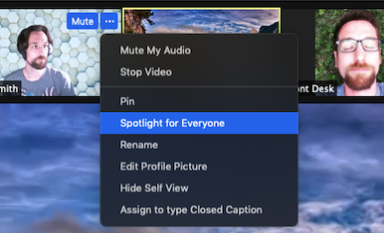
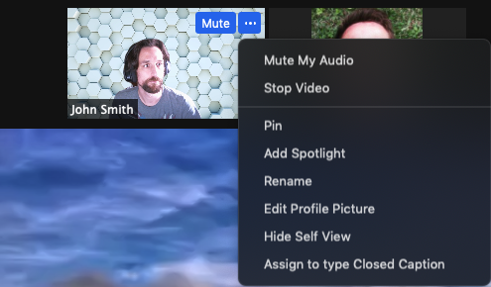
Spotlight Participants

Slide 6
Sharing iPhone/iPad
In a Zoom meeting, click Share Screen.
Choose iPhone/iPad via Cable.
Click Share.
Connect your iPhone or iPad via cable.
When prompted on the iOS device, select Trust.
Enter your passcode if required.
Your device's screen will now be shared into the meeting.

Slide 8
Automated Captioning
Zoom offers the ability to provide live closed captioning during a meeting.
To enable this feature, click on the "Live Transcript" button at the bottom of the screen and select "Enable Auto-Transcription.”
These captions are not ADA compliant. If your course has a student that has an ADA accommodation for captioning, please reach out to the ADA office.

Slide 9
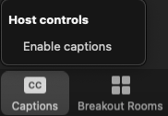

Slide 10
Saving Recordings to BlueCast/Panopto
BlueCast/Panopto has the ability to grab all recordings from a Zoom account and upload it to a personal folder in Panopto.
This will upload all recordings. There is not an option to choose specific recordings
Below is a link to fill out a form to have this setup for you
https://blueq.co1.qualtrics.com/jfe/form/SV_aYqvbAkCVMIRKwS

Slide 11
Questions?

